Slide 1
Sprint 6 Demo
Tuesday, April 19th, 2022

Slide 2
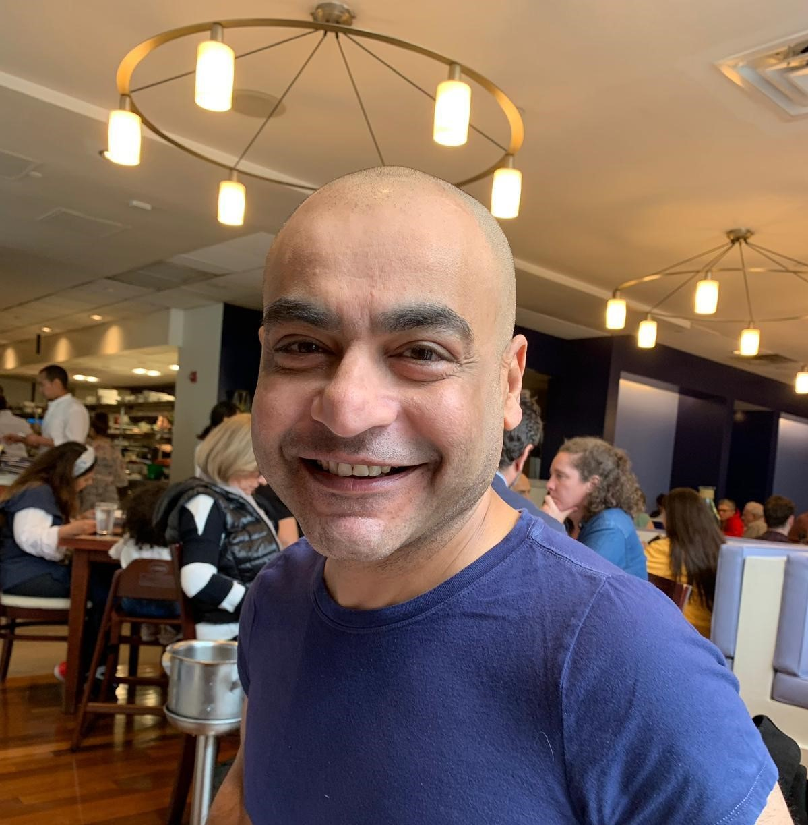

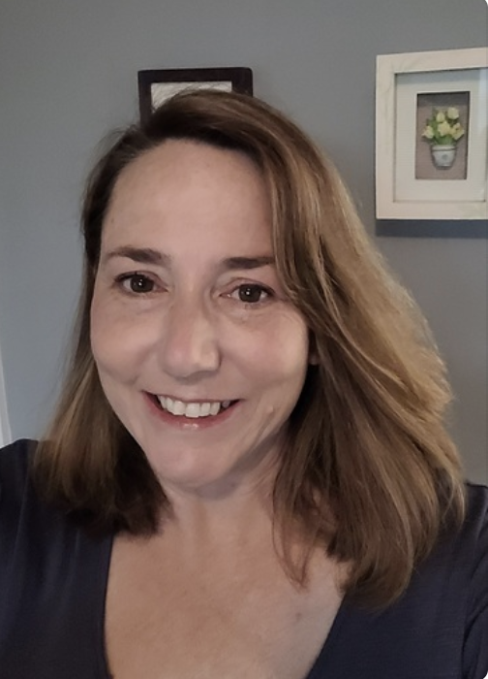
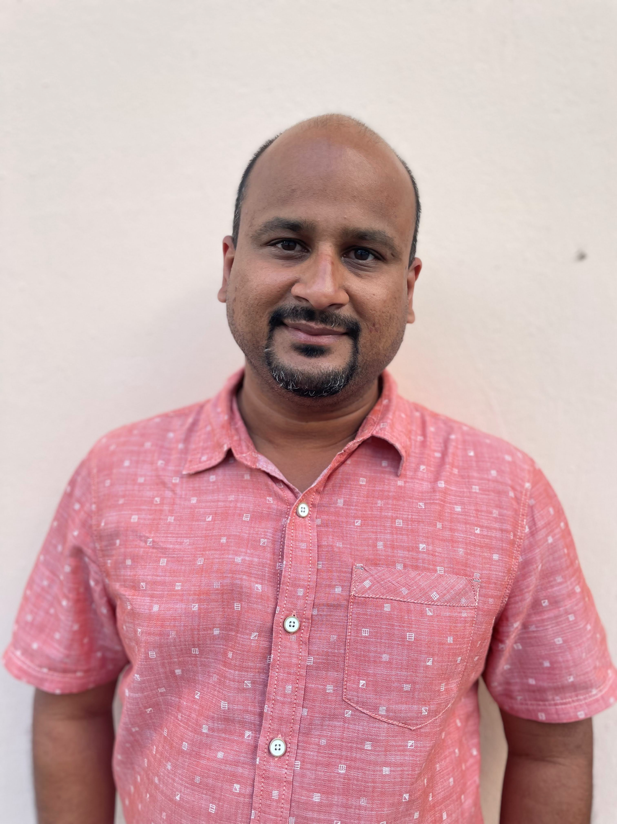









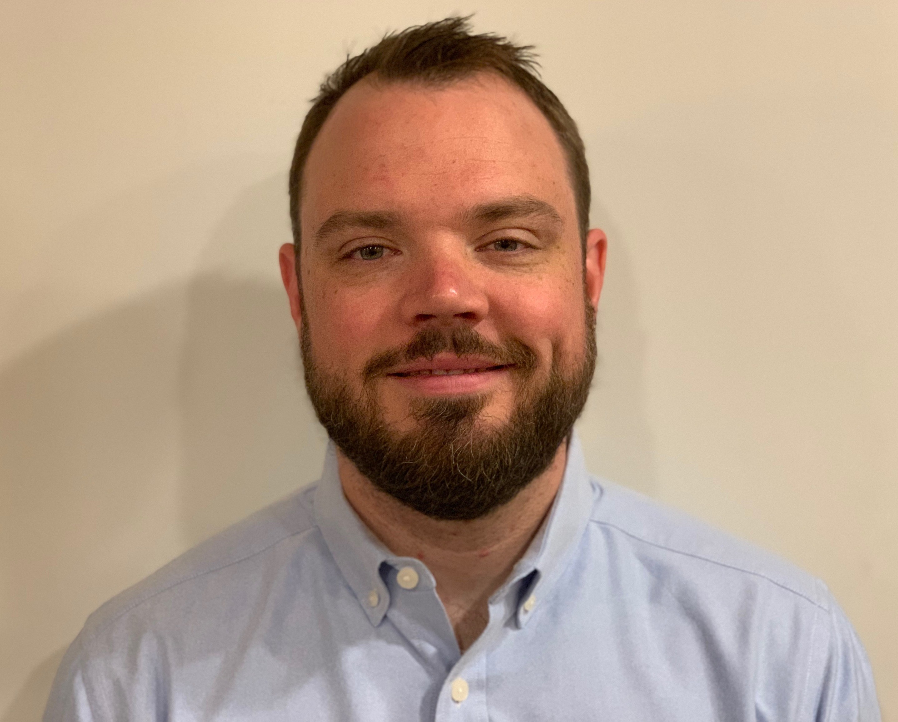
Get to know the team
Frog Design staff roll off, Friday 4/22:
Kit, James, Grace
Core team
Executive team
PRODUCT
ENGINEERING
Munish Sikka
Washington DC
Product Lead
Jordan White Dallas, TX Product Manager
Tami Corson
North Carolina
Clinical SME / Scrum
Shashank Khandelwal
Rockville, MD
Tech Lead
Jeff Scheire
MO Studio
Marcy Jacobs
McKinsey & Co
Kevin London Frog Design
DESIGN
Thomas McCue Chicago, IL Principal Design Director
Carl Dickerson Atlanta, GA Content Strategist and Plain Language Content Creator
Carolyn Williams Chicago, IL Experience
Designer
Teagan Stephenson Ft. Lauderdale, FL Full Stack Engineer
Will Reynolds SERVE Advisory
Ben Morris
Pluribus Digital
Travis Hoffmann
MO Studio
04-19 Sprint 6 Demo
Introduction

Slide 3



At the end of each sprint on Tuesdays, the team will run sprint reviews to showcase the sprint’s work for approval. The purpose of this meeting is:
WELCOME TO THE SPRINT 6 DEMO
1
To demo the accomplishments or functionality that was built over the past sprint
2
To get feedback and insights early and often
3
To create transparency for anyone interested on the product and progress
04-19 Sprint 6 Demo
Introduction

Slide 4
Roadmap overview
WE ARE HERE
PHASE
CY 2021
CY 2022
SPRINT
0
1
2
3
4
5
6
7
8
9
10
11
12
13
14
15
16
17
18
19
20
21
22
23
24
25
MONTH
Sep
Oct
Nov
Dec
Jan
Feb
Mar
Apr
May
Jun
Jul
Aug
FOCUS
DHM - Health Apartment
1095-B Form
Follow ups as needed
Community Care
Health Hub
04-19 Sprint 6 Demo
Introduction

Slide 5




Current Workplan
Owned by design team
Owned by product/ engineering team
Release
WE ARE HERE
SPRINT 3
SPRINT 4
SPRINT 5
SPRINT 6
SPRINT 0
Week 6: 02/23 – 03/02
Week 7: 03/02- 03/09
Week 8: 03/09 – 03/16
Week 9: 03/16 – 03/23
Week 10: 03/23 – 03/30
Week 11: 3/30 – 04/06
Week 12: 04/06-04/13
Week 13: 04/13-04/20
Week 14: 04/13-04/20
Week 15: 04/20-04/27
Product & Delivery
Identify Change Management or Communications Plan
1095-B Handover plan - Prepare for launch
1095-B Legal Review
CC Tech Discovery + Value + Viability
HH Kickoff
User Experience & Design
CC Current User Journey Discovery + Journey Mapping
Voice of Veteran
1095-B Design iterations
HH Kickoff
Engineering & Development
CC Tech Discovery + Current Data & API Landscape
Build solution (form UI, data connections, storage, etc.)
1095-B Test & Refine
HH Kickoff
Collaboration Cycle
Analytics Review
MVP Launch Date Dependent on Legal Review Completion
Content & IA Review
Midpoint Review
Privacy & Security review
Contact Center Review
Staging Review
*Does not show post-MVP Validate phase meetings in Collaboration Cycle, such as Full Accessibility Audit and Post-Launch Check In
Workplan

Slide 6
Agenda
Sprint Goal: For sprint 6 we focused on getting the 1095-B launch-ready and continuing our discovery into the Community Care technology landscape.
1
DESIGN
Updated designs and content to reflect the ability to change one's address for 1095-Bc
Aligned CC landscape with tech
2
TECH
Completed 1095-B build
Technical deep dive on community care
Updated Mural with CC technology system touchpoints
3
PRODUCT
Completed Staging review for 1095-B
Deep dive on CC VHIE (Veterans Health Information Exchange)
Deep dive on CC VDIF EP (Veterans Data Integration & Federation Enterprise Platform)
 | We welcome all feedback! Feedback will be collectively reviewed and prioritized appropriately based on where it stacks against other stories in the backlog as well as technical feasibility.
04-19 Sprint 6 Demo
Agenda

Slide 7
1095-B Overview
SPRINT 6 DEMO
04-19 Sprint 6 Demo

Slide 8
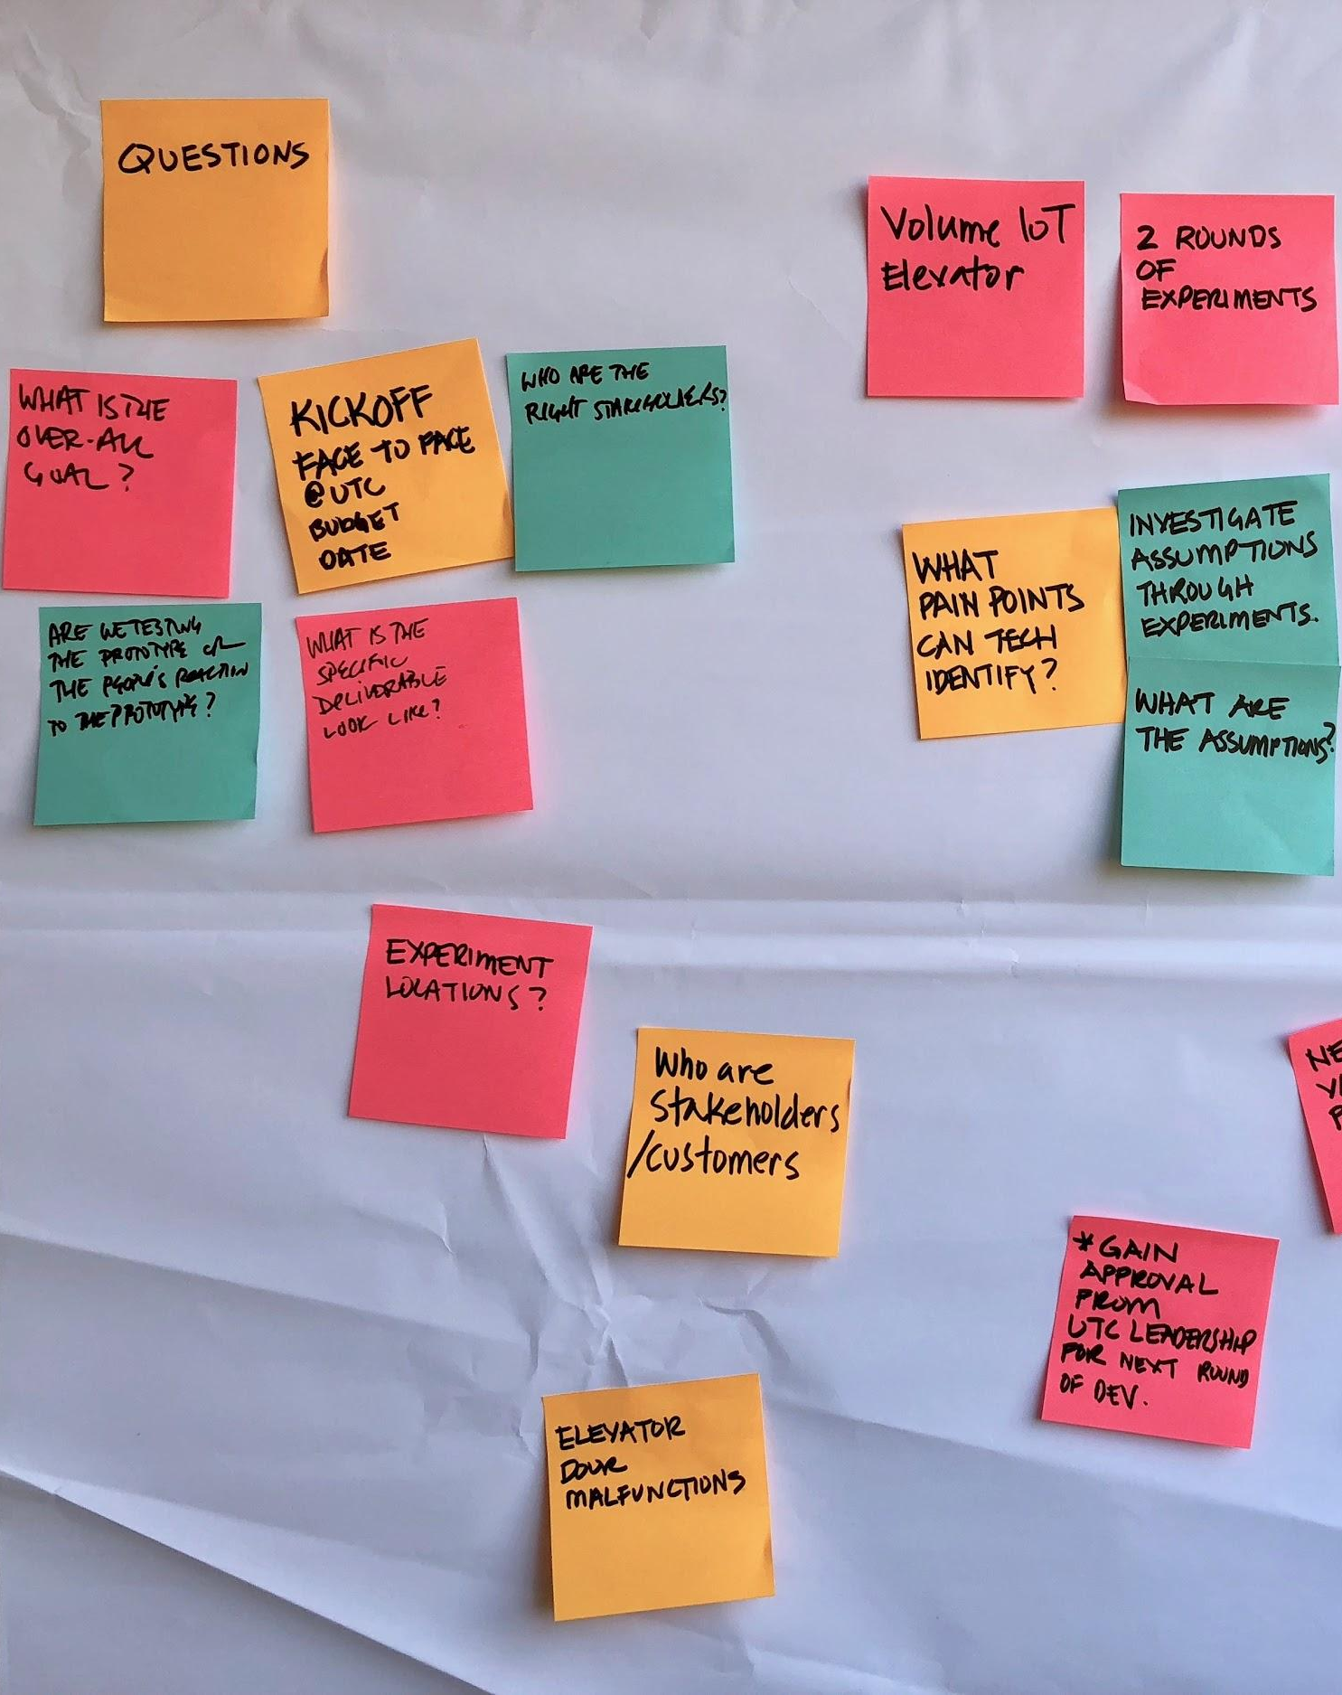
Project objectives
OVERVIEW
Digitize 1095-B form on VA.gov so Veterans can easily access the form and download the form for their records.
04-19 Sprint 6 Demo
Overview

Slide 9


1
DESIGN
2
TECH
We got the 1096-B launch-ready (and approved!)
User Story: Conduct design QA of coded designs
User Story: Iterate designs from staging review feedback
User Story: Collaboration cycle: staging review
User Story: Make updates to code based on feedback from VA GitHub review for staging
Went through Staging Review on April 12 and were cleared for launch. Accessibility and UAT will happen post-launch
Coordinated content feedback tickets with sitewide team
GitHub Link
04-19 Sprint 6 Demo
Design
9

Slide 10
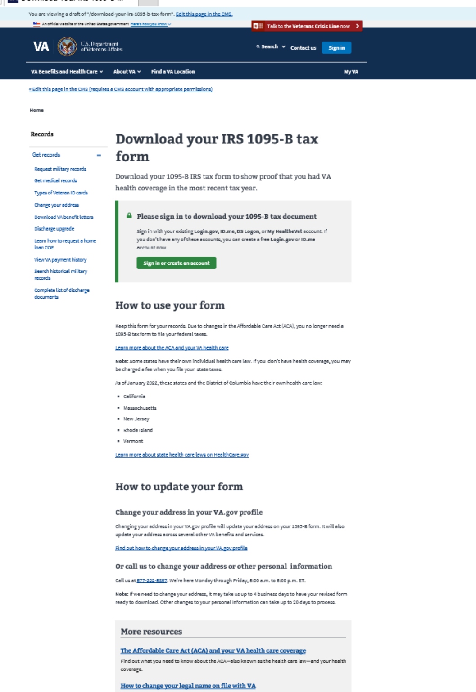
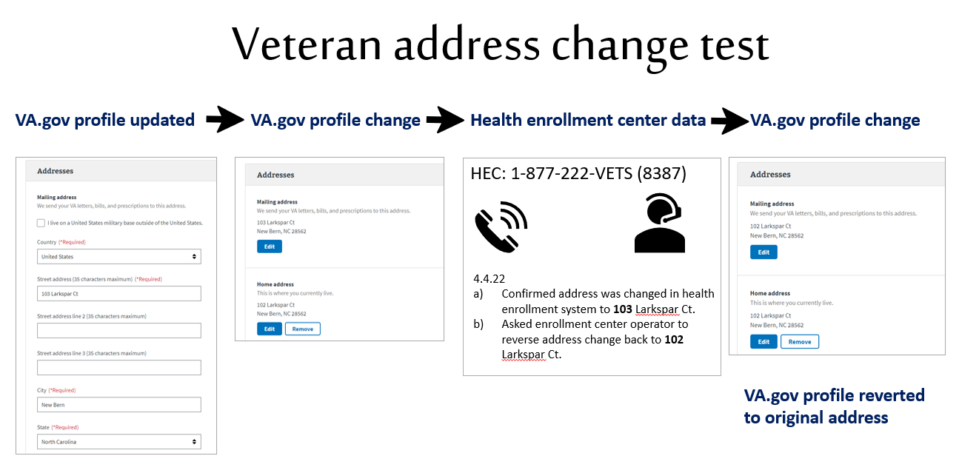
1
DESIGN
3
PRODUCT
We validated that an updated address reflected in both VA Profile and the HEC, and iterated our designs to match
User Story: Update materials for HEC and contact center to reflect address change using VA profile
User Story: Iterate designs to include content and address change by sitewide
User Story: Address change option built into landing page
User Story: Verify enrollment system address can be updated from profile
Confirmed that if a Veteran updates their address in VA profile, it's reflected in the HEC enrollment system, and vice versa
If a Veteran updates their address on profile, they still must wait up to four days to receive a corrected 1095-B
Communicated changes to sitewide team
Link
04-19 Sprint 6 Demo
Design
10

Slide 11
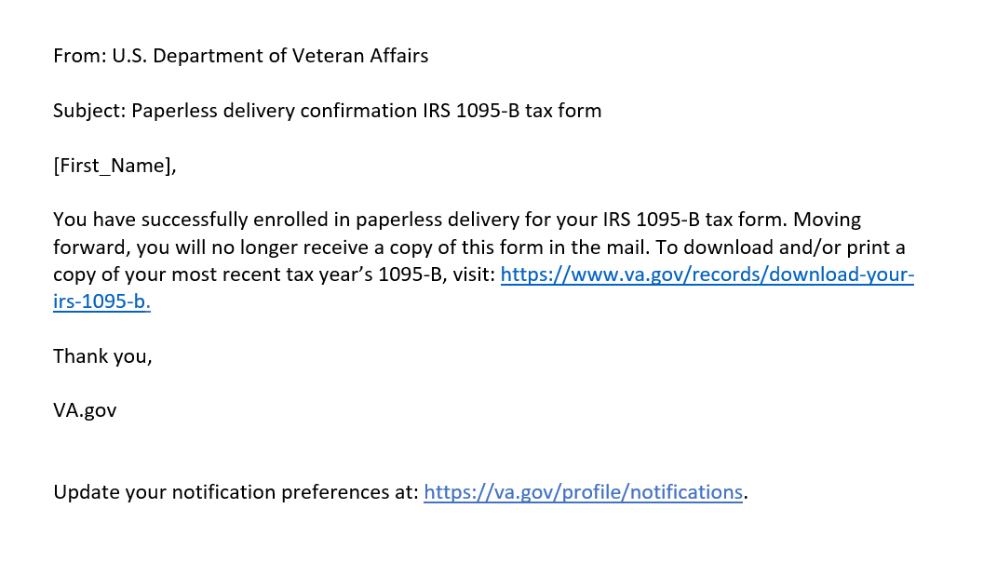
1
DESIGN
We drafted a final confirmation notification for a Veteran who opts-in to digital delivery
User Story: As a Veteran, I want to be informed that my 1095-B will only be delivered digitally when I opt-in to digital delivery
Link
04-19 Sprint 6 Demo
Design
11

Slide 12
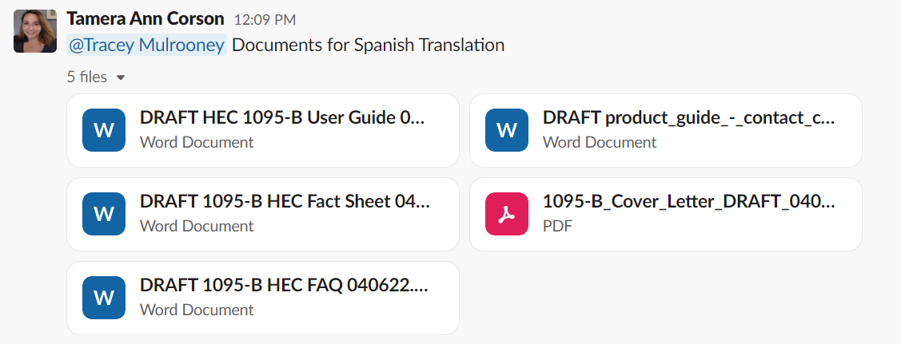
3
PRODUCT
We started the process of getting all required 1095-B documents translated into Spanish
User Story: Understand what is needed to translate HEC documents into Spanish and the impact on timeline
Transmittal link
04-19 Sprint 6 Demo
Product
12

Slide 13
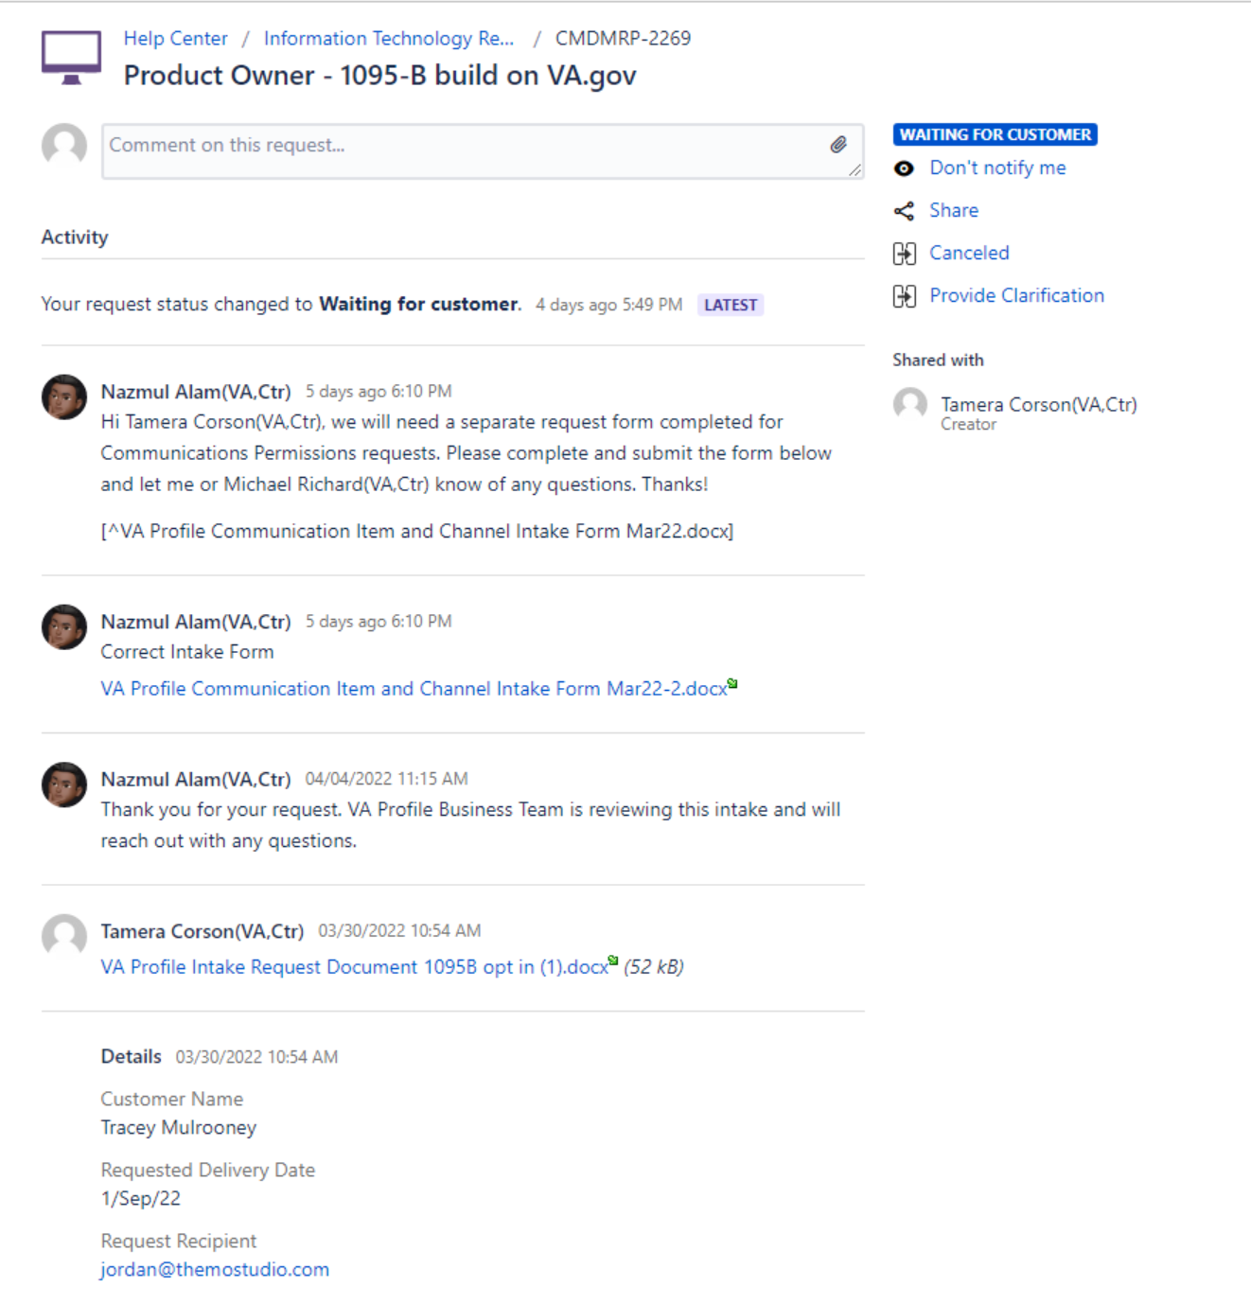
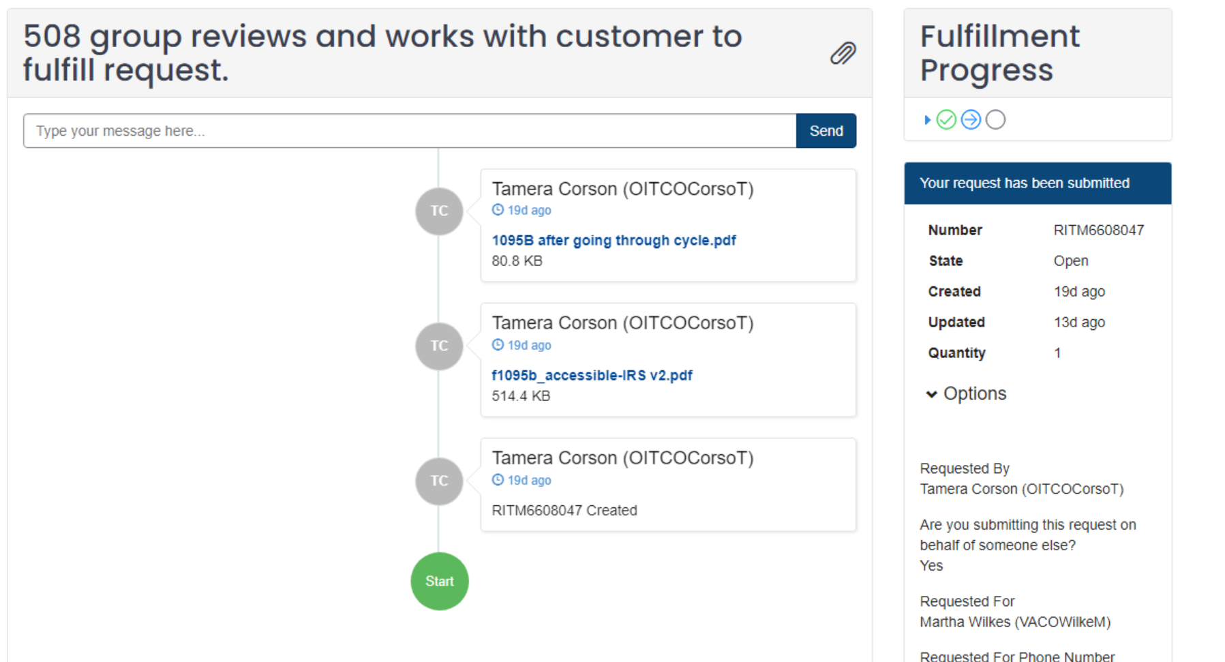
Follow up on outstanding external tickets for 508 assistance and VA Profile Opt-in
3
PRODUCT
User Story: PM team to f/u on VA 508 accessibility ticket
User Story: PM team to f/u on VA notify ticket for opt-in
508 Ticket & VA Profile opt-in ticket
04-19 Sprint 6 Demo
Product
13

Slide 14
Blockers for 1095-B launch
BLOCKER | OWNED BY | ACTION NEEDED | DATE ENTERED | STATUS | NOTES
Legal review | Tarsha Tremble (Business Owner) | Business Owner is seeking a POC with the Office of General Counsel to understand requirements for legal review and timeline | Sprint 3 - 3/2/22 |  | Team is awaiting further word on legal review after follow up from Chris Johnson
Frontend re-design by sitewide content team | Danielle Theirry, Sitewide Content Team | Sitewide Content has redesigned our front-end designs when building it in Drupal to comply with Drupal standards 1095-B team to handoff the download button in widget to Sitewide content, then Sitewide content team will pull in the widget to the front end and own the full front end Sitewide Content to own and manage any changes on the front end as part of their timeline Sitewide Content to define launch date, since they own front end | Sprint 4 – 3/15/22 |  | Team passed the following Collaboration Cycle milestones, with our version of designs: Midpoint Review on 3/04/22 Content & IA Review on 3/09/22 (finalized URL)
PDF Accessibility | Tarsha Tremble (Business Owner) | Team received PDF from IRS, but PDF is still not accessible once it is populated with data | Sprint 3 – 3/3/22 |  | Team is awaiting further word from 508 office
04-19 Sprint 6 Demo
1095-B Blockers

Slide 15
1095-B Remaining actions, with external dependencies
ITEM | WORK STREAM | ACTION NEEDED | TARGET COMPLETE DATE | PREREQUISITE
Tech refinements & testing | Tech | Update backend and react widget as needed based on staging review and UAT feedback Build out and conduct testing | March – end of Sprint 5 | Product complete in staging
UAT | Product & Tech | Follow Collaboration Cycle guidelines for UAT Identify Veterans within VA to conduct UAT, send access, and follow up to ensure testing complete | March – April | Product must be complete in staging
1095-B Opt-in | Product | Follow up with HEC and Profiles team to ensure opt-in is done Update draft communications and announcement plans, based on when opt-in will be launched | April - May | HEC and Profiles commitment to building opt-in
Legal Review | Product | Work with Tarsha to complete legal review | March – April | POC name from Tarsha
Post Launch Check- In | Product | Complete Collaboration Cycle milestone to KPIs post launch | TBD (One month after launch and announcement) | Product launched in prod
Links from VA.gov pages to 1095-B | Product & Design | Work with IA team to have other identified pages within VA.gov (e.g., ACA page) link to the 1095-B page Work with IA team to have 1095-B page added to navigation and be found in VA.gov search | April or later | Product launched in prod; aligned on comm plan with Tarsha, Tracey
1095-B update strategy | Product | Align on who will own 1095-B long term, including updating the PDF template each year | April or later | Product complete and launched in production
Communications to announce launch | Product & Design | Work with Tarsha and HEC team to refine drafted communications and align on plan and timeline to announce 1095-B launch to Veterans Work with VA Notify team to build and launch communications on their platform | October - December | Product launched in prod; aligned on communication plan with Tarsha/Tracey
04-05 Sprint 6 Demo
1095-B Remaining actions

Slide 16
Community Care
SPRINT 6 DEMO
04-19 Sprint 6 Demo

Slide 17
Community Care focused workplan v2
WE ARE HERE
SPRINT 6
SPRINT 0
Week 12: 04/06-04/13
Week 13: 04/13-04/20
Week 14: 04/20-04/27
Week 15: 04/27-05/04
Product & Delivery
Build Backlog
Tech Discovery & Research & Interviews
1095-B
HH Kickoff
User Experience & Design
Immersion
Draft Current State Journey Map
HH Kickoff
1095-B
Engineering & Development
CC Current Technology Landscape
HH Kickoff
Tech Interviews
1095-B
04-19 Sprint 6 Demo
Community Care

Slide 18
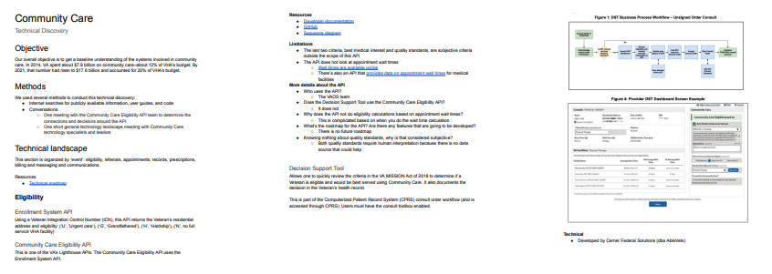
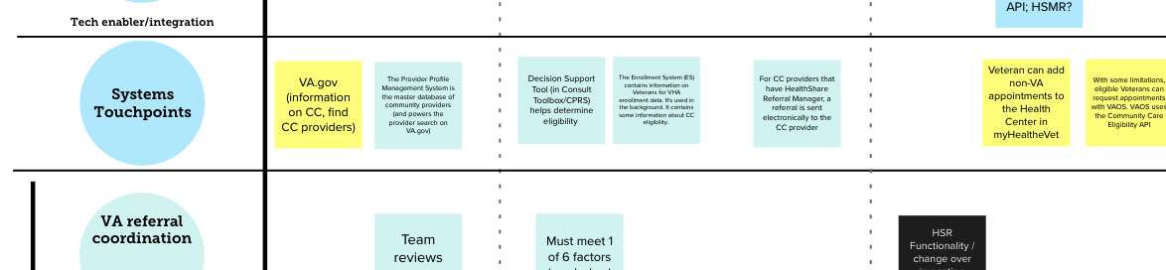
We conducted a high-level technical discovery into the systems that drive Community Care
2
TECH
User Story: CC: Iterate journey map based on additional findings from discovery activities
User Story: CC: Deeper dive into technical discovery with business partners(s)
User Story: CC: Overlay tech finding(s) on journey map
User Story: CC: Draft high-level current state of data elements (system of records)
We built a catalog of the systems that are used in Community care, mostly using online publicly-available sources of information. We had a few conversations with other technology teams to validate and expand on information we'd found.
Technical discovery document​
Systems touchpoints are overlaid on the journey map
04-19 Sprint 6 Demo
Community Care

Slide 19
Sprint Deliverables
SPRINT 6 DEMO
04-19 Sprint 6 Demo

Slide 20
Sprint 6 Deliverables 1095-B (1 of 2)
Teagan
EPIC | STORY | ESTIMATE | ASSIGNED | OUTPUT | REVIEWED W/ VA-PO | SPRINT TEAM GOAL COMPLETED?
Design | #38035 Conduct design QA of coded designs | 1 | James | Sitewide production model Unauthenticated desktop (final) Unauthenticated mobile (final) | 4/19/22 | ✓
Design | #39276 As a Veteran, I want to be informed that my 1095-B will only be delivered digitally when I opt-in to digital delivery | 5 | Carl | Letter (final draft) | 4/15/22 | ✓
Design | #39583 Update materials for HEC and Contact Center to reflect address change using VA profile | 5 | Carl | 1095-B HEC user guide 1095-B HEC fact sheet 1095-B HEC FAQ Contact center product guide | 4/15/22 | ✓
Design | #39581 Iterate designs to include content and address change widget by sitewide | 5 | Carl Grace | Unauthenticated desktop (final) Unauthenticated mobile (final) Authenticated desktop (final) Authenticated mobile (final) | 4/13/22 | ✓
Design | #37043 Iterate designs from staging review feedback | 1 | Grace | Unauthenticated desktop (final) Unauthenticated mobile (final) Authenticated desktop (final) Authenticated mobile (final) | 4/13/22 | ✓
Design | #40008 Platform orientation checklist [Carolyn Williams] | 5 | Carolyn | Ticket | N/A | ✓
Design | #40009 Platform orientation checklist [Thomas McCue} | 5 | Thomas | Ticket | N/A | ✓
Tech | #39769 Make updates to code based on feedback from VA GitHub review for staging | 5 | Teagan | Ticket G#20208 Ticket G#9423 Ticket G#9430 | 4/15/22 | ✓
Tech | #39922 Platform orientation checklist [Shashank Khandelwal] | 5 | Shashank | Ticket | N/A | ✓
04-19 Sprint 6 Demo
Sprint 6 Deliverables

Slide 21
Sprint 6 Deliverables 1095-B (2 of 2)
EPIC | STORY | ESTIMATE | ASSIGNED | OUTPUT | REVIEWED W/ VA-PO | SPRINT TEAM GOAL COMPLETED?
PM | #38921 Verify enrollment system address can be updated from profile | 2 | Tami | Test report Address ∆ process | 04/06/22 | ✓
PM | #38351 Collaboration cycle: Staging Review [1095-B] | 0 | Munish | Ticket | 04/15/22 | ✓
PM | #36175 Collaboration cycle: Analytics Implementation or QA Support for [1095-B] | 0 | Munish | Ticket | 04/15/22 | ✓
PM | #39582 Address change option built in landing page | 1 | Jordan | Sitewide Ticket Prototype | 04/15/22 | ✓
PM | #39515 Understand what is needed to translate HEC documents into Spanish and the impact on product timeline | 3 | Jordan | Link to doc transmittal | 04/15/22 | ✓
PM | #38144 Platform orientation [Munish Sikka] | 5 | Munish | Ticket | N/A | ✓
PM | #39723 PM team to f/u on VA notify ticket for opt-in | 0 | Jordan Tami | Ticket CMDMRP-2269 | N/A | ✓
PM | #39722 PM team to f/u on 508 accessibility support ticket | 0 | Tami Jordan | yourIT ticket | N/A | ✓
04-19 Sprint 6 Demo
Sprint 6 Deliverables

Slide 22
Sprint 6 Deliverables Community Care
EPIC | STORY | ESTIMATE | ASSIGNED | OUTPUT | REVIEWED W/ VA-PO | SPRINT TEAM GOAL COMPLETED?
P | #39657 CC: Iterate journey map based on additional findings from discovery activities | 8 | James Grace Teagan | Journey map | 4/19/22 | ✓
D | #40069 CC: Overlay tech findings on journey map | 2 | Shashank | Journey map v3 | 4/19/22 | ✓
D | #39656 CC: Draft high-level current state of data elements (systems of record) | 13 | Shashank Teagan | Technical discovery | 4/19/22 | ✓
D | #39658 CC: Deeper dive into technical discovery with business partner(s) | 13 | Shashank Teagan | Notes from mtg w/ George et. al. Notes from mtg w/ Daniel | 4/19/22 | ✓
04-19 Sprint 6 Demo
Sprint 6 Deliverables

Slide 23
Preview of Sprint 1
SPRINT 6 DEMO
04-19 Sprint 6 Demo

Slide 24
Sprint 1 of Health Hub will focus on
 | Next sprint demo: May 3rd
PRODUCT
Initial discovery
Vision framework formulation
Business partners identification
1
*Stories subject to change during Sprint planning
2
DESIGN
Conduct initial discovery of current state of health products on VA.gov
Create list of potential business partners for discovery
3
TECH
Conduct initial tech discovery of current health products on VA.gov
Map out high-level data flows through current state
Create list of potential business partners for discovery
04-19 Sprint 6 Demo
Preview of Sprint 0 – Health Hub

Slide 25
Sprint 1 will run April 20 to May 3rd
Owned by design team
Owned by product/ engineering team
Release
WE ARE HERE
SPRINT 1
SPRINT 2
SPRINT 3
SPRINT 4
SPRINT 5
Week 1: 04/20 – 04/26
Week 2: 04/27 – 05/03
Week 3: 05/04 – 05/10
Week 4: 05/11- 05/17
Week 5: 05/18 – 05/24
Week 6: 05/25 – 05/31
Week 7: 06/01 – 06/07
Week 8:
06/08 – 06/14
Week 9: 06/15-06/21
Week 10: 06/22-06/28
Product & Delivery
1095-B: Identify Change Management or Communications Plan
1095-B: Legal Review
1095-B: Handover plan - Prepare for launch
1095-B: Opt-in follow up
1095-B: Spanish translation docs
HH: Charter
HH: Develop backlog + Vision Framework
HH: Roadmap
User Experience & Design
1095-B: Wayfinding plan
Testing prep & recruiting
Voice of Veteran
Voice of Veteran
HH: Discovery
HH: Stakeholder Interviews
HH: Current State Journey Map
Prioritized plan
Engineering & Development
HH: Tech discovery
HH: Stakeholder Interviews
HH: Proposed tech integrations based off research findings
Collaboration Cycle
Midpoint Review
1095-B: Launch Date Dependent on Legal Review Completion
Research Plan Review
Research Plan Review
*Does not show post-MVP Validate phase meetings in Collaboration Cycle, such as Full Accessibility Audit and Post-Launch Check In; Contact Center Review adjusted to 3 weeks before launch as approved by Jason Woodman
Preview of Sprint 7

Slide 26
Appendix
SPRINT 6 DEMO

Slide 27
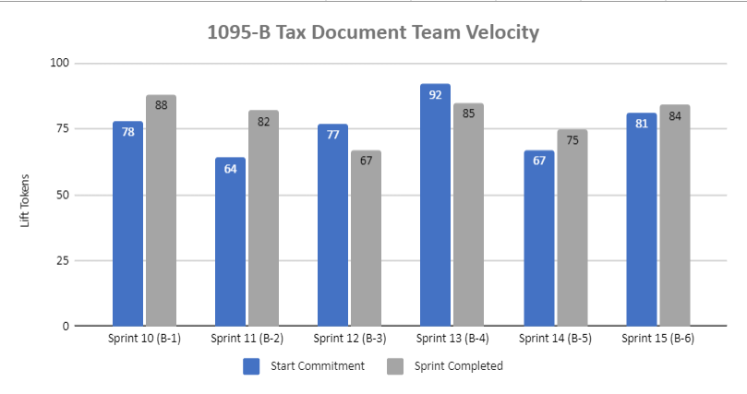
1095-B Team velocity
 | Velocity details Velocity estimated in story points, using Fibonacci Velocity in Sprint 6 accounted for 11 team members 84 total story points were completed; Team committed to 81 story points at beginning of the sprint, 11 were blocked, 3 removed, and 17 additional story points added. 11 story point blocked due to a)inability to test accessibility in staging environment, must complete during dark launch b) outstanding assistance request ticket with VA 508 office; adding to next sprint unless further blocked by legal review 3 story points were removed due to inability to conduct discovery with care navigators. 17 story points were added due to onboarding 3 new team members (15) and midcycle addition of combining tech discovery with design discovery on journey map (2). All collaboration cycle events and follow up on tickets submitted in prior sprint were not assigned story points
04-19 Sprint 6 Demo
Appendix
27

Slide 28
Project risks and mitigation strategies
Munish to update
Submitted as part of the Monthly Report for March
RISK AND IMPACT | MITIGATION STRATEGY | DATE |  | STATUS | NOTES
 |  | ENTERED | CLOSED
IRS stakeholder is outside of VA ecosystem. Building without guidance or legal review regarding compliance with IRS regulation could result in risk. | Conduct research on available information surrounding current IRS 1095-B tax form regulations. Seek legal review through VA resources as directed by VA-PO and Business Owner | 1/20/22 | 2/11/22 |  | VA Business Owner clarified that IRS review is not needed
Team had previously confirmed with Business Owner that legal review was not needed. Business Owner clarified that legal review would be needed as of March 2nd | Business Owner is seeking a POC with the Office of General Counsel to understand what is needed and potential launch impact | 3/2/22 |  |  | Launch blocker
Data requires storage in a S3 bucket that the enrollment system can have access to in production; process to create the staging and production bucket does not have a clear timeline. Without the S3 bucket in prod with enrollment system access, product cannot be built in prod | Daily follow-ups with Jesse House and Mike Chelan (infrastructure team) | 3/1/22 | 3/24/22 |  | S3 bucket now in place. Risk resolved.
Business owner raised User Acceptance Testing should be done with HEC Call Center | Requested Business Owner to schedule UAT with required individuals for mid-March and book as early as possible | 3/2/22 | 3/25/22 |  | Business owner confirmed that UAT can be done through Collaboration Cycle and does not have to be done with HEC team
Feedback from Content and IA Review has taken over a week to come in; feedback is changing our proposal for the H1 and delaying confirmation of where the 1095-B landing page should live, which in turn delays our ability to complete the front end (top nav and side nav bars) | Design team pushing on IA team to confirm final answer of where 1095-B landing page should live and what the H1 header title should be | 03/04/22 | 3/8/22 |  | URL confirmed 3/7 EOD; IA review now closed
Designs were approved as part of Midpoint Review. Afterwards, Sitewide Content stated they would need to build our front end in Drupal and change our designs, impacting our in-flight build. | Design team met with Sitewide Content to align on redesigned front end. Tech working with Sitewide Content to send over our dynamic widget to be pulled into their static front end. Sitewide Content now owns the front end build. | 3/10/22 |  |  | Launch date dependent on Sitewide Content ability to launch front end

Slide 30
2
TECH
Lorem
User Story: Lorem
User Story: Lorem
User Story: Lorem
User Story: Lorem
User Story: Lorem
Lorem
Lorem
Lorem
Lorem
Lorem
Lorem
Lorem
Link
04-19 Sprint 6 Demo
Tech
30

Slide 31
2
TECH
Lorem
User Story: Lorem
User Story: Lorem
User Story: Lorem
User Story: Lorem
User Story: Lorem
Lorem
Lorem
Lorem
Lorem
Lorem
Lorem
Lorem
Link
04-19 Sprint 6 Demo
Tech
31

Slide 32
2
TECH
Lorem
User Story: Lorem
User Story: Lorem
User Story: Lorem
User Story: Lorem
User Story: Lorem
Lorem
Lorem
Lorem
Lorem
Lorem
Lorem
Lorem
Link
04-19 Sprint 6 Demo
Tech
32

Slide 33
Lorem
3
PRODUCT
User Story: Lorem
User Story: Lorem
User Story: Lorem
User Story: Lorem
Lorem
Lorem
Lorem
Lorem
Lorem
Lorem
Lorem
Link
04-19 Sprint 6 Demo
Product
33

Slide 34
Lorem
3
PRODUCT
User Story: Lorem
User Story: Lorem
Link
04-19 Sprint 6 Demo
Community Care
34

Slide 35
Lorem
3
PRODUCT
User Story: Lorem
User Story: Lorem
Link
04-19 Sprint 6 Demo
Product
35

Slide 36
Lorem
1
DESIGN
User Story: Lorem
User Story: Lorem
Lorem
Lorem
Lorem
Lorem
Lorem
Lorem
Lorem
Lorem
Lorem
Lorem
Lorem
Lorem
Link
04-19 Sprint 6 Demo
Community Care

